Slide 1
What is RSA?
RSA is one of the most widely used public-key cryptography systems. It’s named after its inventors: Rivest, Shamir, and Adleman (1977).

Slide 2
In Simple Terms:
RSA lets you:
Encrypt data so only the intended recipient can read it.
Digitally sign data to prove that it came from you.
It’s used in:
HTTPS (SSL/TLS) for secure websites
Digital signatures
Secure email (PGP)
SSH, VPNs, and more

Slide 3
RSA is Asymmetric Cryptography
Unlike symmetric cryptography (like AES), RSA uses two keys:
Public Key → anyone can use it to encrypt
Private Key → only the owner can decrypt
Analogy:
You have a padlock (public key) and a key (private key).
Anyone can lock the box (encrypt), but only you can unlock it.

Slide 4
How RSA Works
Generate Keys:
Choose two large prime numbers p , q
Compute n = p * q
Compute ϕ(n) = (p-1)(q-1)
Choose a public exponent e (like 65537)
Compute private key d such that d * e ≡ 1 mod ϕ(n)
2. Public Key: (n, e)
Private Key: (n, d)
Encryption: ciphertext = (message^e) mod n
Decryption: message = (ciphertext^d) mod n

Slide 5
RSA Variables Explained
Symbol | Name | Meaning
p | Prime 1 | A large random prime number
q | Prime 2 | Another large random prime number
n | Modulus | n = p × q — used in both public and private keys
ϕ(n) or phi | Totient of n | ϕ(n) = (p−1)(q−1) — number of integers less than n that are coprime to n
e | Public exponent | Chosen number that is coprime with ϕ(n) (e.g., 65537 is common)
d | Private exponent | Computed as the modular inverse of e modulo ϕ(n), i.e. d ≡ e⁻¹ mod ϕ(n)
m | Message | The original plaintext number (before encryption)
c | Ciphertext | Encrypted message, calculated as c ≡ m^e mod n
d_p, d_q, q_inv | CRT values (optional) | Optimization values used to speed up decryption (used in practice)

Slide 6
Why is RSA Secure?
Because it's extremely hard to factor a huge number n into its primes p and q.
Weaknesses (When Used Incorrectly)
RSA is mathematically strong, but:
Using small primes or reused keys makes it breakable
That’s where tools like RsaCtfTool can help find vulnerabilities

Slide 7
Common RSA Attacks
Small Prime Factors
If n is made from small primes, it can be easily factored.
Tools can find p and q from n, then compute d.
Low Public Exponent (e.g., e = 3)
If e is small and message is too short, attacker can decrypt using m = c^(1/e).
Common Modulus Attack
Same n, different e1, e2 used for encrypting same message → attacker can recover plaintext using extended Euclidean algorithm.
Reused Primes
Two keys share the same prime → GCD(n1, n2) reveals it!
Wiener’s Attack
If d is too small → attacker can use continued fractions to find it.

Slide 8
Tool: RsaCtfTool
A Python tool for breaking weak RSA keys in CTFs or real-world misconfigurations.
Features:
Factors n
Detects low e
Detects shared primes
Wiener attack
Many others...

Slide 9
RsaCtfTool Installation
cd Desktop
sudo apt update
git clone https://github.com/Ganapati/RsaCtfTool.git
cd RsaCtfTool
pip install -r requirements.txt
PYTHONPATH=src python3 src/RsaCtfTool/main.py
PYTHONPATH=src python3 src/RsaCtfTool/main.py -n 2898320609 -e 65537 --decrypt 1350216472

Slide 10
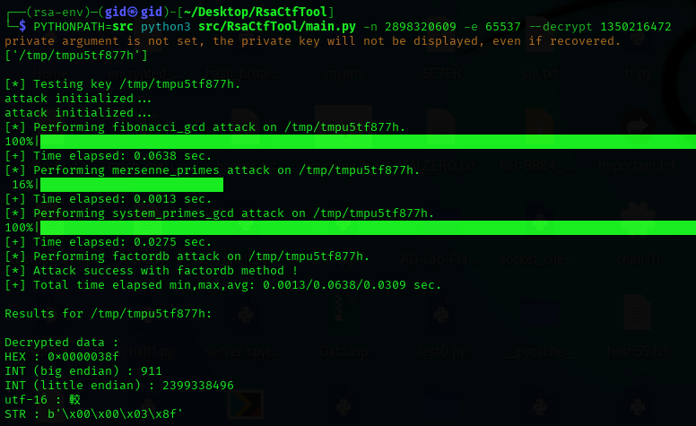
RsaCtfTool Practicale

Slide 11
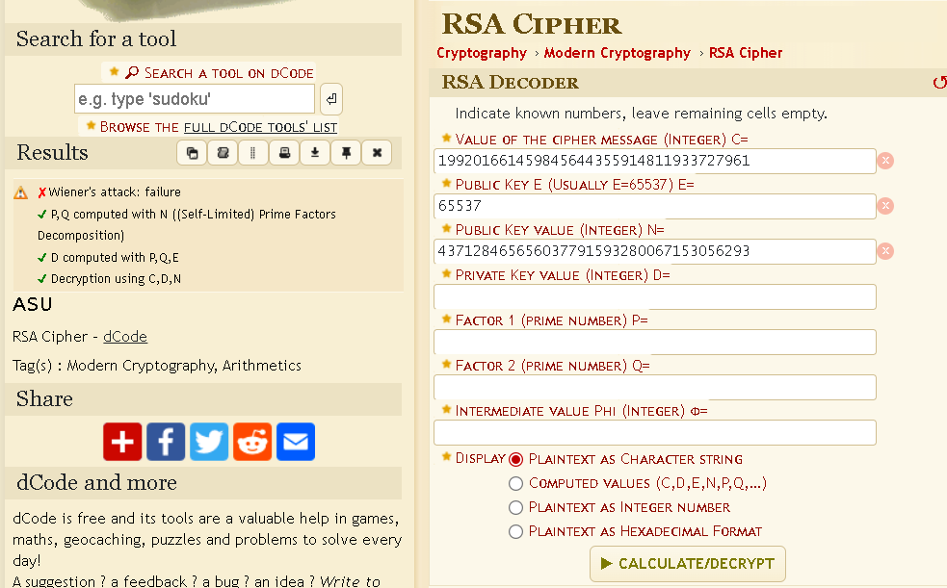
https://www.dcode.fr/rsa-cipher

